Slide 1
Measuring dissimilarity with diffeomorphism invariance
Théophile Cantelobre
Inria & ENS, The Inria London Programme
Joint work with C. Ciliberto, B. Guedj, A. Rudi
Imaging in Paris Seminar
Institut Henri Poincaré
02/04/2024

Slide 2
Théophile Cantelobre
PhD Student in the SIERRA Team at Inria Paris
Engineer from Mines Paris - PSL
Some topics and projects : structured prediction, approximate kernel methods, PSD models, filtering, …
Outside of work : community building
Open to work: looking for a full-time Machine Learning Engineer position in Paris starting in September 2024.
Raccoon credits: Adrien Bukato

Slide 3
Measuring dissimilarity with diffeomorphism invariance
ICML 2022 (Baltimore)
Paper : arxiv.org/abs/2202.05614
Code repository : github.com/theophilec/diffy
Raccoon credits: Adrien Bukato

Slide 4
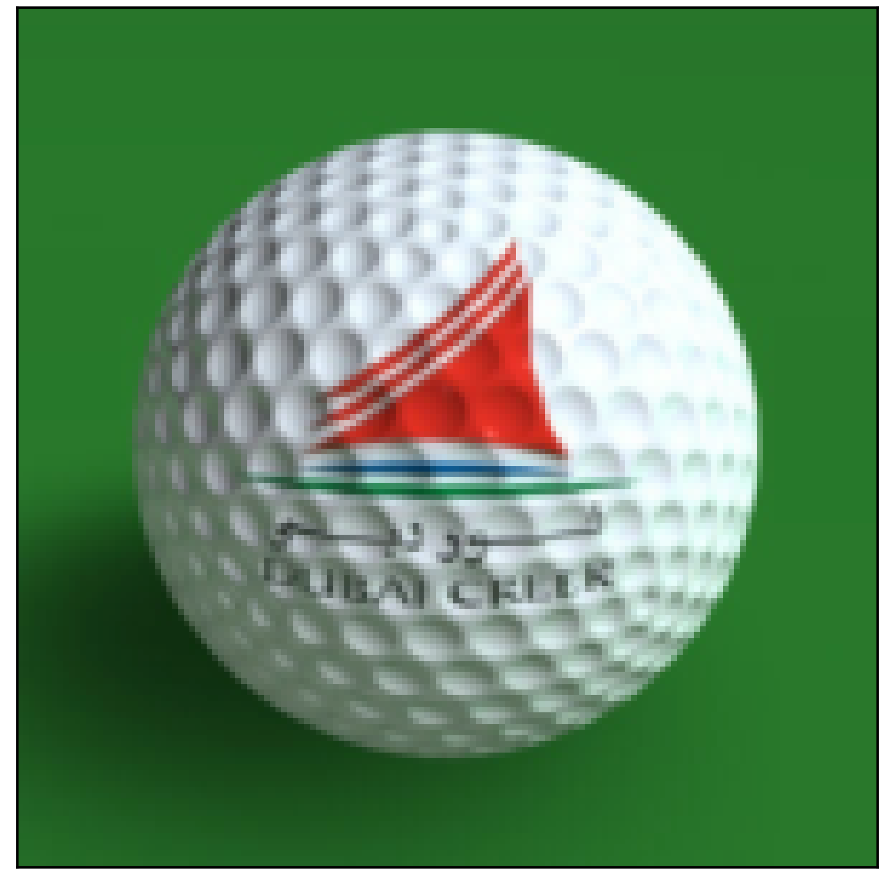
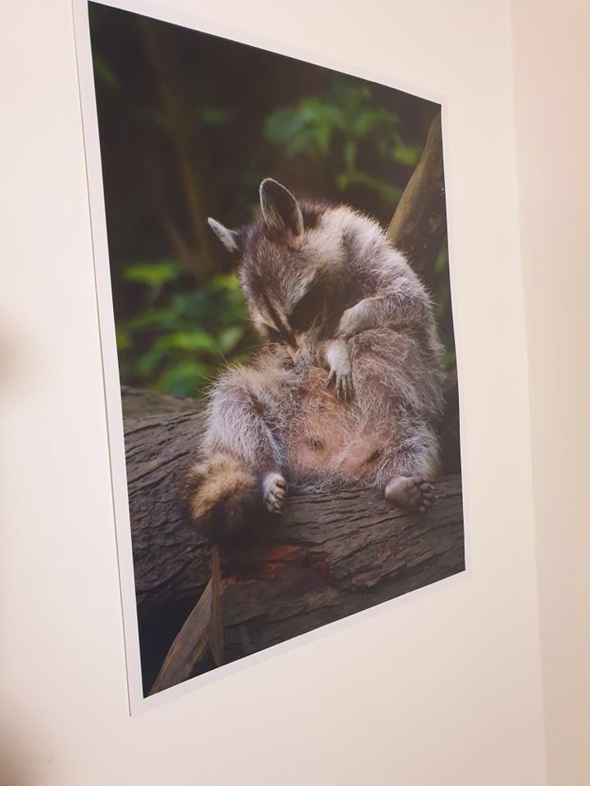
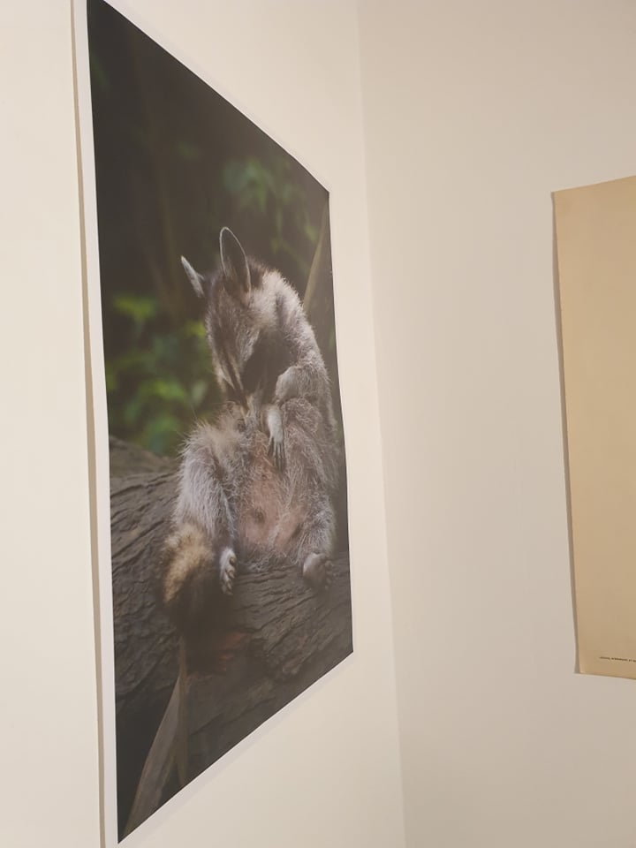

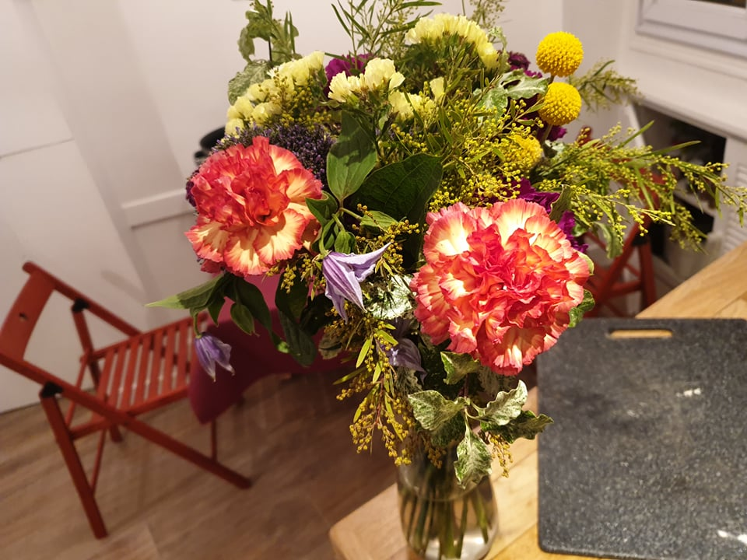
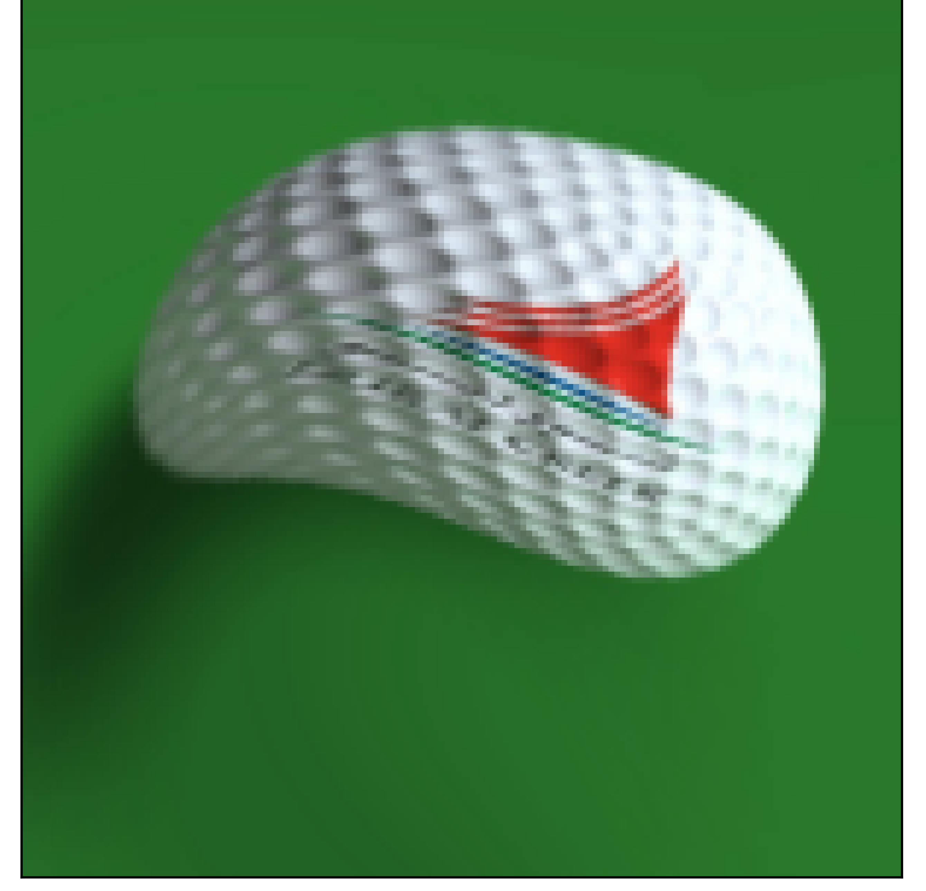
Setting
Using distances to analyse data: classification, clustering, retrieval, …
Deformations in the wild: perspective, rotation, translation, warping, …
Raccoon credits: Adrien Bukato

Slide 5
Problem statement
Find a distance between images which is invariant to deformations and computable in practice.
Some conceptual difficulties :
- which deformations are interesting to capture ?
- what is a deformation on a discrete grid ?
Find a dissimilarity between functions which is invariant to smooth diffeomorphisms and computable in practice.

Slide 6
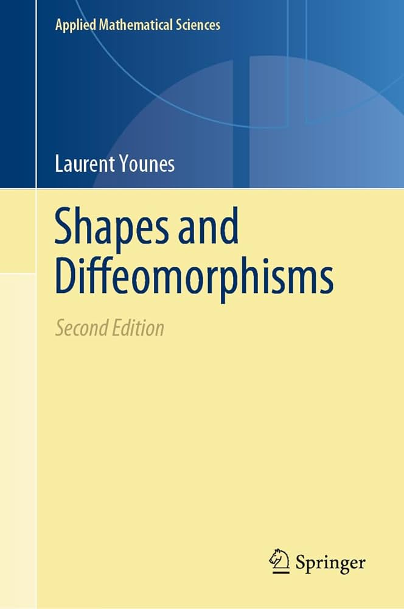
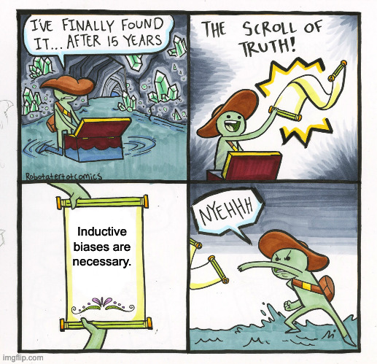
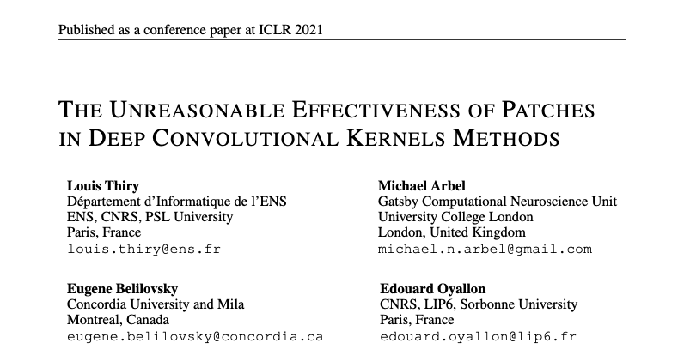
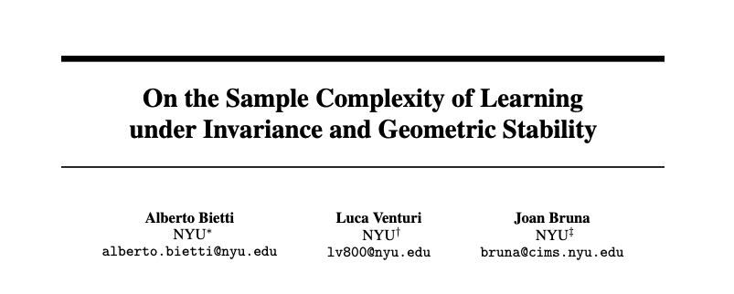
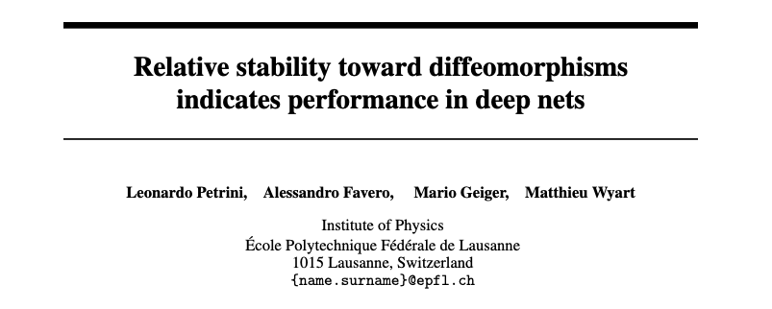
Related work
Related work

Slide 7
What to expect for the rest of this talk
Data as functions
Informal derivation
Theoretical guarantees
How to compute it
Demo!

Slide 8





Seeing images as functions

Slide 9
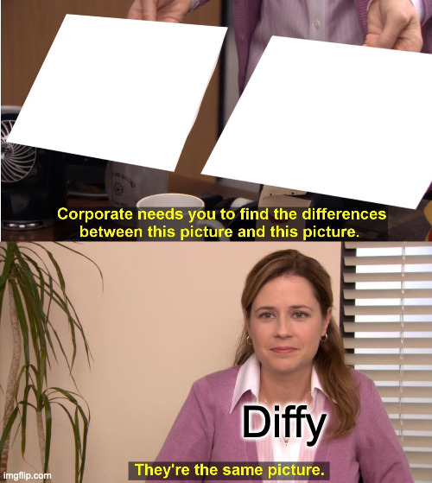


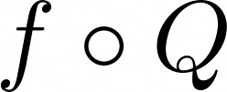
Informal derivation
Our goal

Slide 10
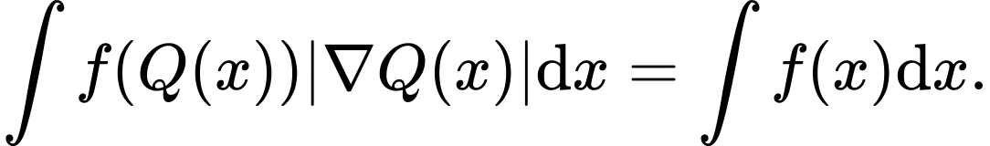
Informal derivation
Main idea: change of variable
unknown

Slide 11
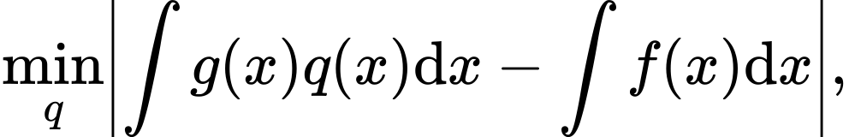
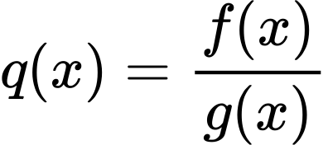
1. Regress jacobian term
unknown

Slide 12
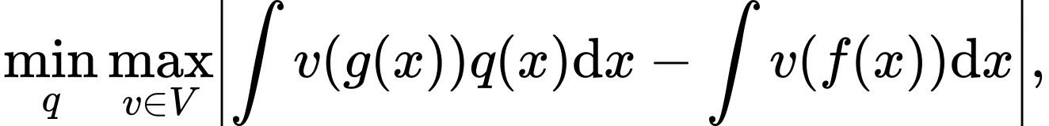



Informal derivation
2. Avoid trivial solutions: match moments
unknown
achieves equality

Slide 13

Informal derivation
3. Enforce uniformity on regions
unknown
achieves equality

Slide 14




Informal derivation
Scary formula Formal definition
RKHS over the domain
RKHS over the color space
For any region on f…
…which matches all statistics…
…find the region on g…
…using only smooth jacobians.

Slide 15



Game theory analogy
Player 1
Player 2
Goal: find hardest
region h of f.
Goal: seeing h, match it with region q of g.

Slide 16
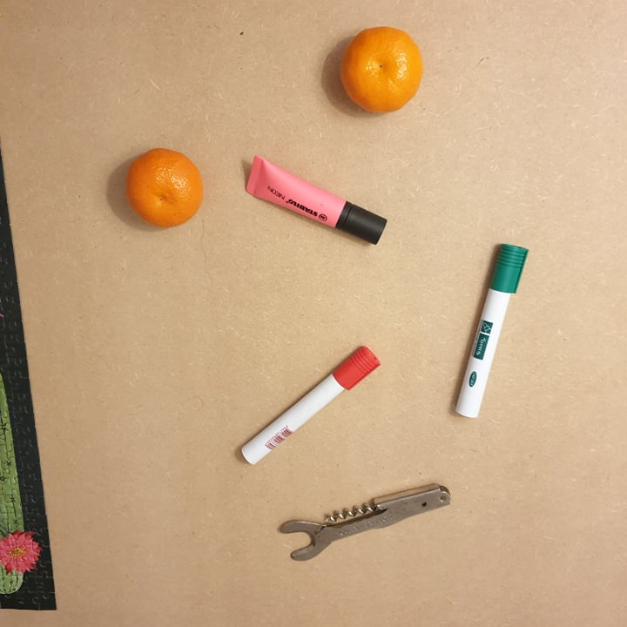
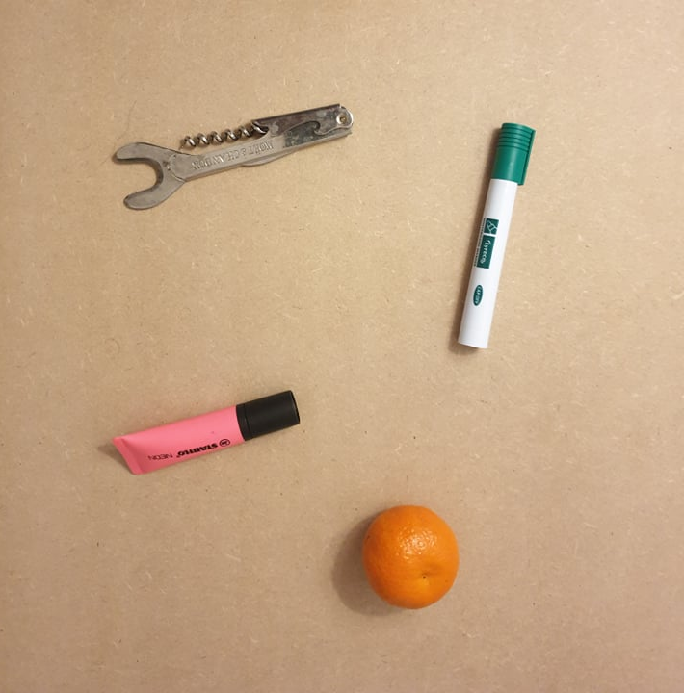
Game theory analogy
Player 1
Player 2
Goal: find hardest
region h of f.
Goal: seeing h, match it with region q of g.

Slide 17

Back to our examples

Slide 18
OK… but does it work?
What would the dream result be?

Slide 19
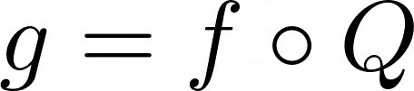

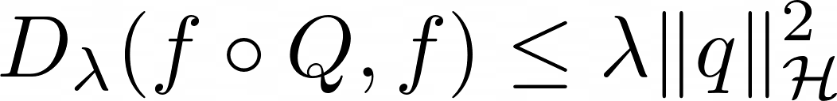
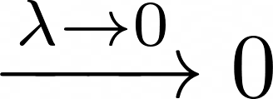
Theorem & proof sketch
Intuition
If , then for any take
and
Theorem
Proof sketch
Control smoothness of compositions
Construct smooth change of variable q
Control norm of change of variable q

Slide 20


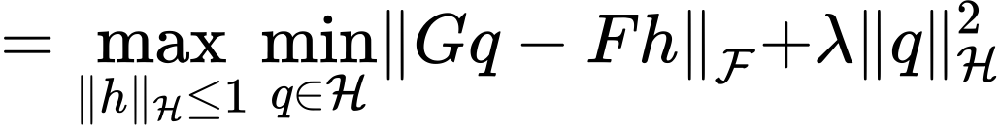
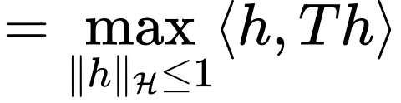
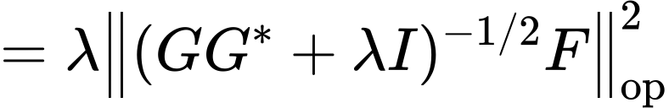
Closed-form computation
Generalized ridge regression
Eigenvalue problem

Slide 21
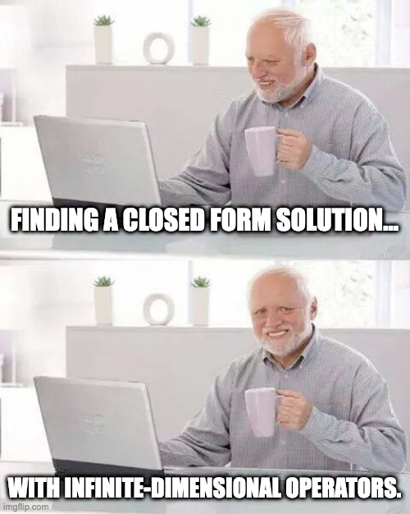
Computing Diffy in practice

Slide 22
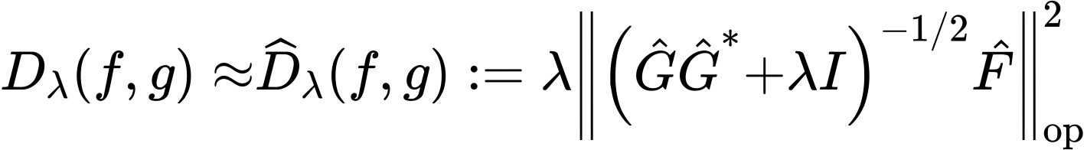
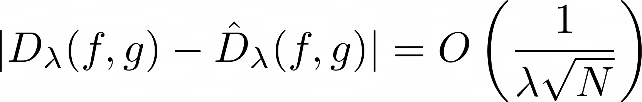
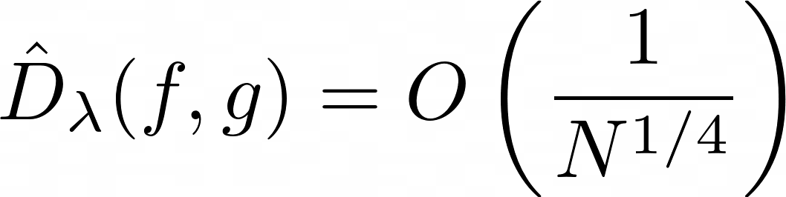
Diffy in practice
Results
a) With smooth kernels and enough Nystrom points:
b) With smooth kernels, enough Nystrom points and smooth Q:
Computational complexity
b) With smooth kernels, enough Nystrom points and smooth Q:

Slide 23
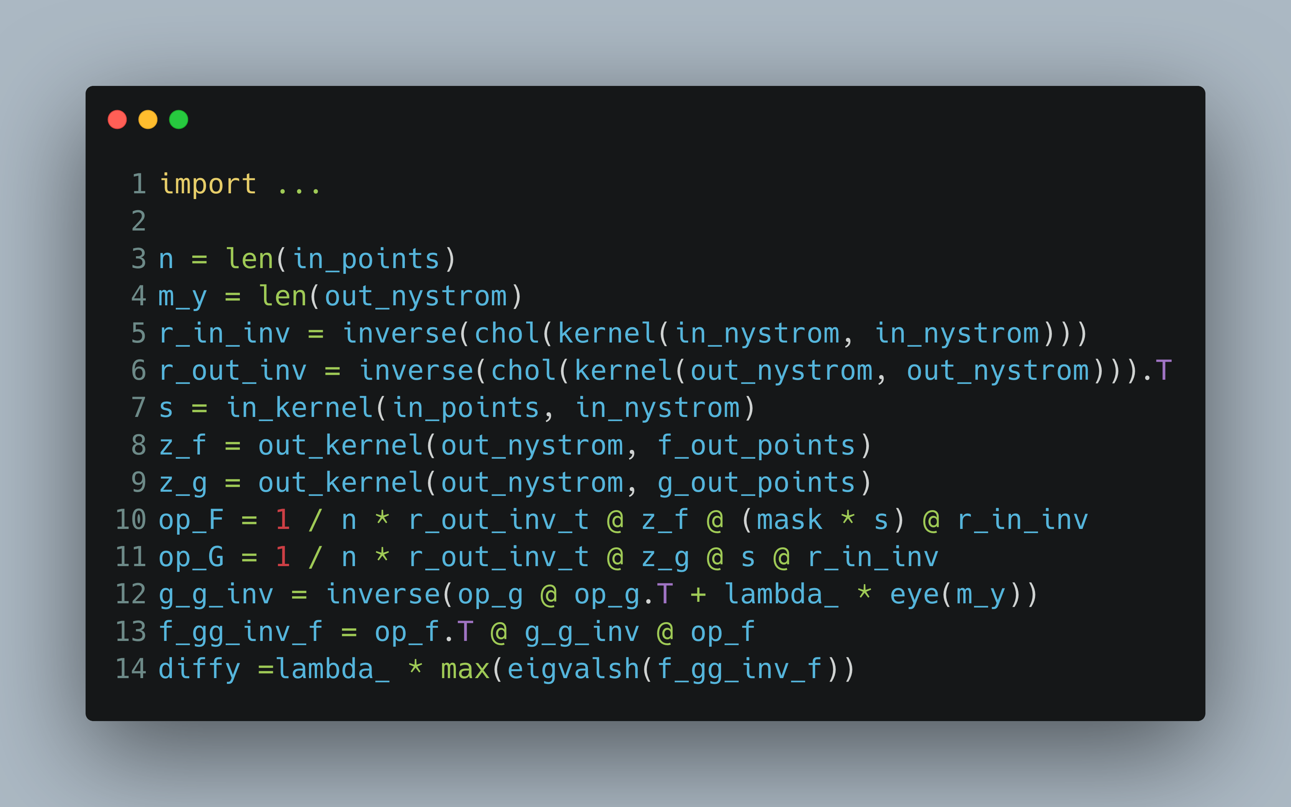

Slide 24
Summary
Leveraging the power of kernels : data as functions between low-dimensional spaces.
- Intuitive dissimilarity that is small for data with small diffeomorphic perturbations.
- Efficient approximation with same behavior.

Slide 25
Positive examples (1)
Notes:
Highlight that is small ➔ same order as lambda

Slide 26
Positive examples (3)

Slide 27
Positive examples (4)

Slide 28
Negative example

Slide 29
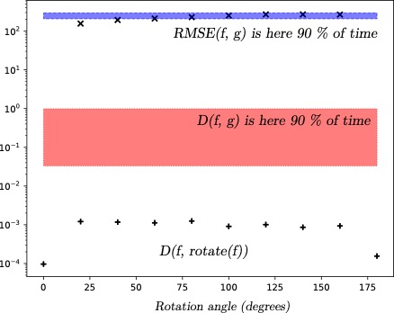
Invariance to rotation

Slide 30
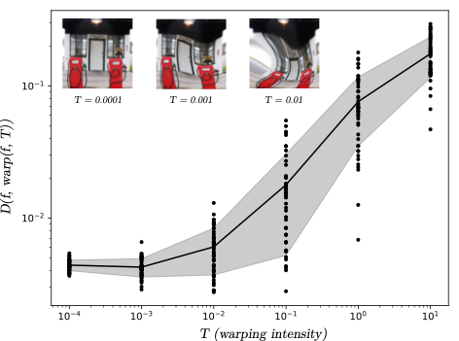
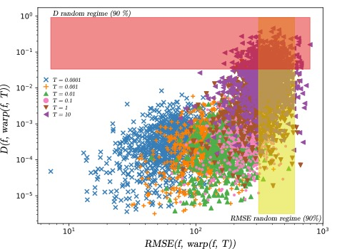
Invariance to warping

Slide 31
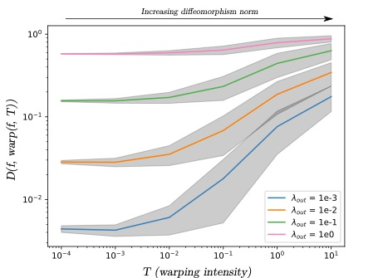
Effect of regularization

Slide 32


Learning more:
https://arxiv.org/abs/2202.05614 & https://github.com/theophilec/diffy

Slide 33


*Focus on central reference object

